Slide 3
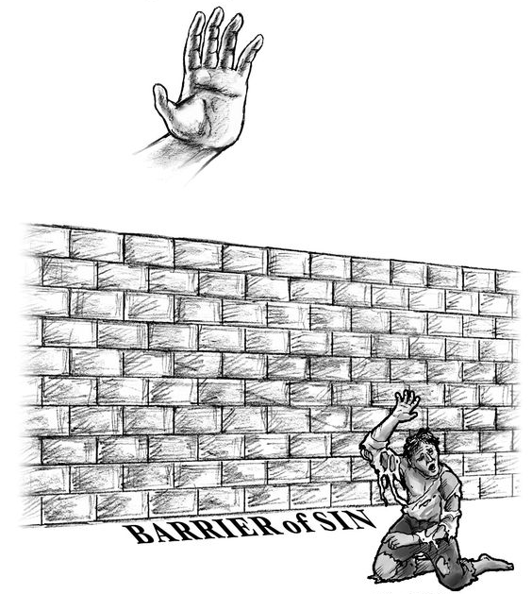
Holy God (No Sin In Him)
Sinful Man (Spiritually Unclean)

Slide 4
All Under Condemnation:
We Have All (SINNED). Thus: We Are Sinners – Condemned On Basis of Violating and Breaking God’s Law.
Romans 1:18-3:20
But… There Is Hope!
Gospel of Jesus Christ
Romans 1:16
Hopeless On Our Own Power.

Slide 5
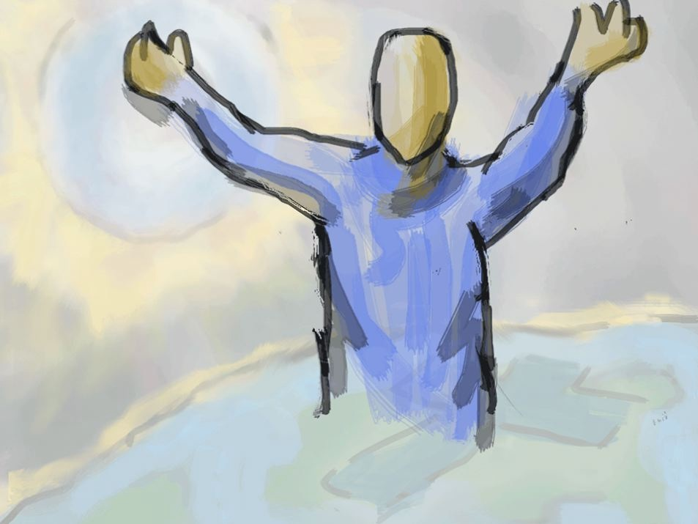

Slide 6
In Christ
For the wages of sin is death, but the free gift of God is eternal life in Christ Jesus our Lord.
Romans 6:23

Slide 7
2:11-15
Titus 3:5-7

Slide 8
5 He saved us, not on the basis of deeds which we have done in righteousness, but according to His mercy, by the washing of regeneration and renewing by the Holy Spirit, 6 whom He poured out upon us richly through Jesus Christ our Savior, 7 so that being justified by His grace we would be made heirs according to the hope of eternal life.
(vs. 4) The Kindness of God
Notes:
Eph. 4:23 “and that you be renewed in the spirit of your mind” Putting on Christ.

Slide 9
He Can Not Justly and Righteously Ignore The Debt Of My Sin. The Debt Of My Sin Must Be Accounted For and Paid For.
“that He might be just and the justifier.”
Romans 3:26

Slide 10
This Is What God Did…
2 Corinthians 5:21 He made Him who knew no sin to be sin on our behalf, so that we might become the righteousness of God in Him.
1 Peter 1:18-19 (18) knowing that you were not redeemed with perishable things like silver or gold from your futile way of life inherited from your forefathers, (19) but with precious blood, as of a lamb unblemished and spotless, the blood of Christ.
1 Peter 2:24 and He Himself bore our sins in His body on the cross, so that we might die to sin and live to righteousness; for by His wounds you were healed.

Slide 11
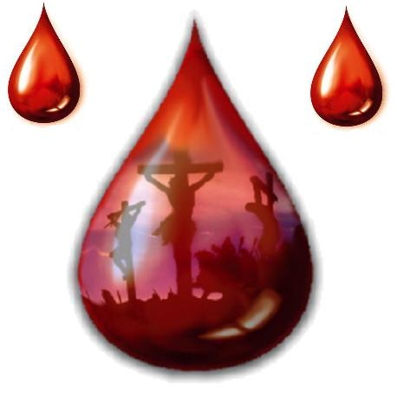
Revelation 1:5 “To Him who loves us and released us from our sins by His blood—”

Slide 12
88 Times In The N.T.
Blessed be the God and Father of our Lord Jesus Christ, who has blessed us with every spiritual blessing in the heavenly places in Christ, Ephesians 1:3

Slide 13
If
(17) Therefore if anyone is in Christ, he is a new creature; the old things passed away; behold, new things have come.
(19) namely, that God was in Christ reconciling the world to Himself, not counting their trespasses against them, and He has committed to us the word of reconciliation.
2 Corinthians 5
Blessed be the God and Father of our Lord Jesus Christ, who has blessed us with every spiritual blessing in the heavenly places in Christ, Ephesians 1:3
Notes:
God’s Message of Reconciliation

Slide 14
It was for this He called you through our gospel, that you may gain the glory of our Lord Jesus Christ.
(2 Thess. 2:14)

Slide 15
“…dealing out retribution to those who do not know God and to those who do not obey the gospel of our Lord Jesus.”
(2 Thess. 1:8)
Problem - SIN!
(vs.9-10)

Slide 16
He who has believed and has been baptized shall be saved.
The Bible Says…
(15) And He said to them, “Go into all the world and preach the gospel to all creation (16) “He who has believed and has been baptized shall be saved; but he who has disbelieved shall be condemned.
Mark 16:15-16

Slide 17
Matt. 28:18-20 (18) And Jesus came up and spoke to them, saying, “All authority has been given to Me in heaven and on earth. (19) “Go therefore and make disciples of all the nations, baptizing them in the name of the Father and the Son and the Holy Spirit, (20) teaching them to observe all that I commanded you; and lo, I am with you always, even to the end of the age.”
Mark 16:15-16; Luke 24:46-46

Slide 18
Mark 16:15-16 (15) And He said to them, “Go into all the world and preach the gospel to all creation (16) “He who has believed and has been baptized shall be saved; but he who has disbelieved shall be condemned.
Matt. 28:18-20; Luke 24:46-46

Slide 19
Luke 24:46-48 (46) and said to them, “Thus it is written, that the Christ should suffer and on the third day rise from the dead, (47) and that repentance and forgiveness of sins should be proclaimed in his name to all nations, beginning from Jerusalem. (48) You are witnesses of these things. (ESV)
Matt. 28:18-20; Mark 16:15-16

Slide 20
Make Disciples Of All The Nations.
Baptizing Them In The Name Of The Father, Son And Holy Spirit.
Teaching Them To Observe All That I Have Commanded You – With You Always To The End Of The Age.
Preach The Gospel
Believes And Is Baptized Will Be Saved
Repentance And Remission Of Sins Should Be Preached In His Name.

Slide 22
37 Now when they heard this they were cut to the heart, and said to Peter and the rest of the apostles, “Brothers, what shall we do?” 38 And Peter said to them, “Repent and be baptized every one of you in the name of Jesus Christ for the forgiveness of your sins, and you will receive the gift of the Holy Spirit. 39 For the promise is for you and for your children and for all who are far off, everyone whom the Lord our God calls to himself.” 40 And with many other words he bore witness and continued to exhort them, saying, “Save yourselves from this crooked generation.” 41 So those who received his word were baptized, and there were added that day about three thousand souls. 42 And they devoted themselves to the apostles' teaching and the fellowship, to the breaking of bread and the prayers.
Acts 2:37-42 ESV

Slide 23
3 Or do you not know that all of us who have been baptized INTO Christ Jesus have been baptized INTO His death? 4 Therefore we have been buried with Him through baptism INTO death, so that as Christ was raised from the dead through the glory of the Father, so we too might walk in newness of life. 5 For if we have become UNITED WITH HIM in the likeness of His death, certainly we shall also be in the likeness of His resurrection, 6 knowing this, that our old self was crucified with Him, in order that our body of sin might be done away with, so that we would no longer be slaves to sin; 7 for he who has died is freed from sin. 8 Now if we have died with Christ, we believe that we shall also live with Him,
Romans 6:3-8
Notes:
Vs. 7-8 We were dead in sin and we choose to die to sin – no longer to live having sin as our master.

Slide 24
26 for in Christ Jesus you are all sons of God, through faith. 27 For as many of you as were baptized into Christ have put on Christ.
This Is How One Puts On Christ.
Out Of An Obedient Faith.
Galatians 3:26-27 ESV

Slide 25
(12) having been buried with Him in baptism, in which you were also raised with him through faith in the powerful working of God, who raised him from the dead. (13) And you, who were dead in your trespasses and the uncircumcision of your flesh, God made alive together with him, having forgiven us all our trespasses,
Notes:
Purpose of baptism… If not baptized with Christ’s baptism then… not buried with Him, Not raised with Him, not had God’s working in this, not made alive, not had our trespasses forgiven.

Slide 26
(12) having been buried with Him in baptism, in which you were also raised with him through faith in the powerful working of God, who raised him from the dead. (13) And you, who were dead in your trespasses and the uncircumcision of your flesh, God made alive together with him, having forgiven us all our trespasses, ESV
If Not Baptized In The Baptism Of Christ
Then…
Not Buried With Him,
Not Raised With Him,
Not Had God’s Working In This
Not Made Alive
Not Had Our Trespasses Forgiven.
Purpose of Baptism…
Do We Bury People Who Are Dead or Alive?
Eph.
2:5-6
Notes:
Purpose of baptism… If not baptized with Christ’s baptism then… not buried with Him, Not raised with Him, not had God’s working in this, not made alive, not had our trespasses forgiven.

Slide 27
(7) “BLESSED ARE THOSE WHOSE LAWLESS DEEDS HAVE BEEN FORGIVEN, AND WHOSE SINS HAVE BEEN COVERED. (8) “BLESSED IS THE MAN WHOSE SIN THE LORD WILL NOT TAKE INTO ACCOUNT.”
Romans 4:7-8

Slide 29
Romans 6

