Slide 1
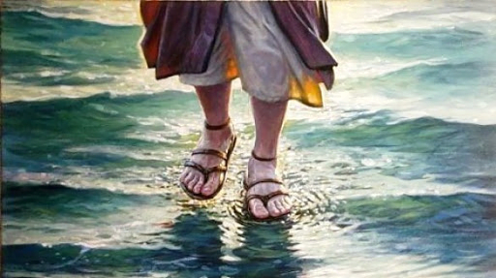
A Storm Story Matthew 14:22-33

Slide 2
“He speaks to the sun and it does not shine; he seals off the light of the stars. He alone stretches out the heavens and treads on the waves of the sea” - Job 9:7-8

Slide 3
1. God is with us in the midst of the storm
2. Obedience to God brings benefits that only God can provide
3. Following Christ requires us to do some things that don’t come naturally to us

Slide 4
“When they got into the boat, the wind ceased. Then those in the boat worshipped him and said, ‘Truly you are the son of God.’” - Matthew 14:32-33

Slide 5
A Storm Story Matthew 14:22-33

