Slide 1
severe one tie to attach to another - Paul loved Timothy.

Slide 2
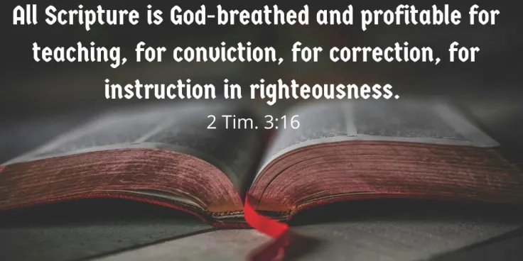
John 13:9 Jesus said to him, “Have I been so long with you, and yet you have not come to know Me, Philip? He who has seen Me has seen the Father; how can you say, ‘Show us the Father’? 10 Do you not believe that I am in the Father, and the Father is in Me? The words that I say to you I do not speak on My own initiative, but the Father abiding in Me does His works.

Slide 3
John 14:7
If you had known Me, you would have known My Father also; from now on you know Him, and have seen Him.”

Slide 4
Mark 4:17 From that time Jesus began to preach and say, “Repent, for the kingdom of heaven is at hand.”
Revelation 11:15
Then the seventh angel sounded; and there were loud voices in heaven, saying, “The kingdom of the world has become the kingdom of our Lord and of His Christ; and He will reign forever and ever.”

Slide 5
Matthew 13:11
Jesus answered them, (the 12) “To you it has been granted to know the mysteries of the kingdom of heaven, but to them it has not been granted.
Mark 4:33-34
With many such parables He was speaking the word to them, so far as they were able to hear it; and He did not speak to them without a parable; but He was explaining everything privately to His own disciples.
John 16:12 “I have many more things to say to you, but you cannot bear them now.

Slide 6
Acts 1:6
“Lord, is it at this time You are restoring the kingdom to Israel?”

Slide 7
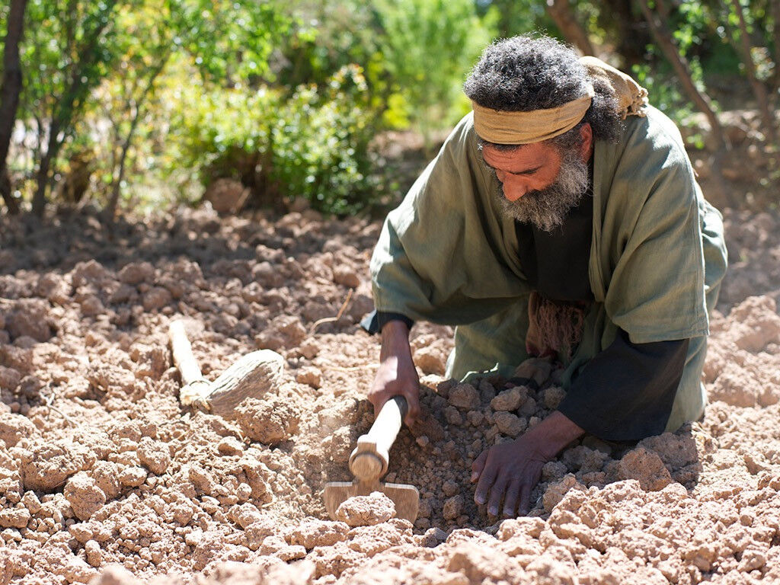
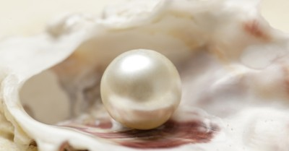

Slide 8
Matthew 5:3
“Blessed are the poor in spirit, for theirs is the kingdom of heaven.
Matthew 5:10
“Blessed are those who have been persecuted for the sake of righteousness, for theirs is the kingdom of heaven.
Matthew 5:19
…he shall be called great in the kingdom of heaven.
Matthew 5:20
“For I say to you that unless your righteousness surpasses that of the scribes and Pharisees, you will not enter the kingdom of heaven.

Slide 9
Matthew 7:21
“Not everyone who says to Me, ‘Lord, Lord,’ will enter the kingdom of heaven, but he who does the will of My Father who is in heaven will enter.
Matthew 8:11
I say to you that many will come from east and west, and recline at the table with Abraham, Isaac and Jacob in the kingdom of heaven;
Matthew 10:7
And as you go, preach, saying, ‘The kingdom of heaven is at hand.’
Matthew 11:11
Truly I say to you, among those born of women there has not arisen anyone greater than John the Baptist! Yet the one who is least in the kingdom of heaven is greater than he.

Slide 10
Matthew 13:24
“The kingdom of heaven may be compared to a man who sowed good seed...
Matthew 13:31
“The kingdom of heaven is like a mustard seed…
Matthew 13:33
“The kingdom of heaven is like leaven…
Matthew 13:44
“The kingdom of heaven is like a treasure hidden in the field…
Matthew 13:45
“Again, the kingdom of heaven is like a merchant seeking fine pearls…

Slide 11
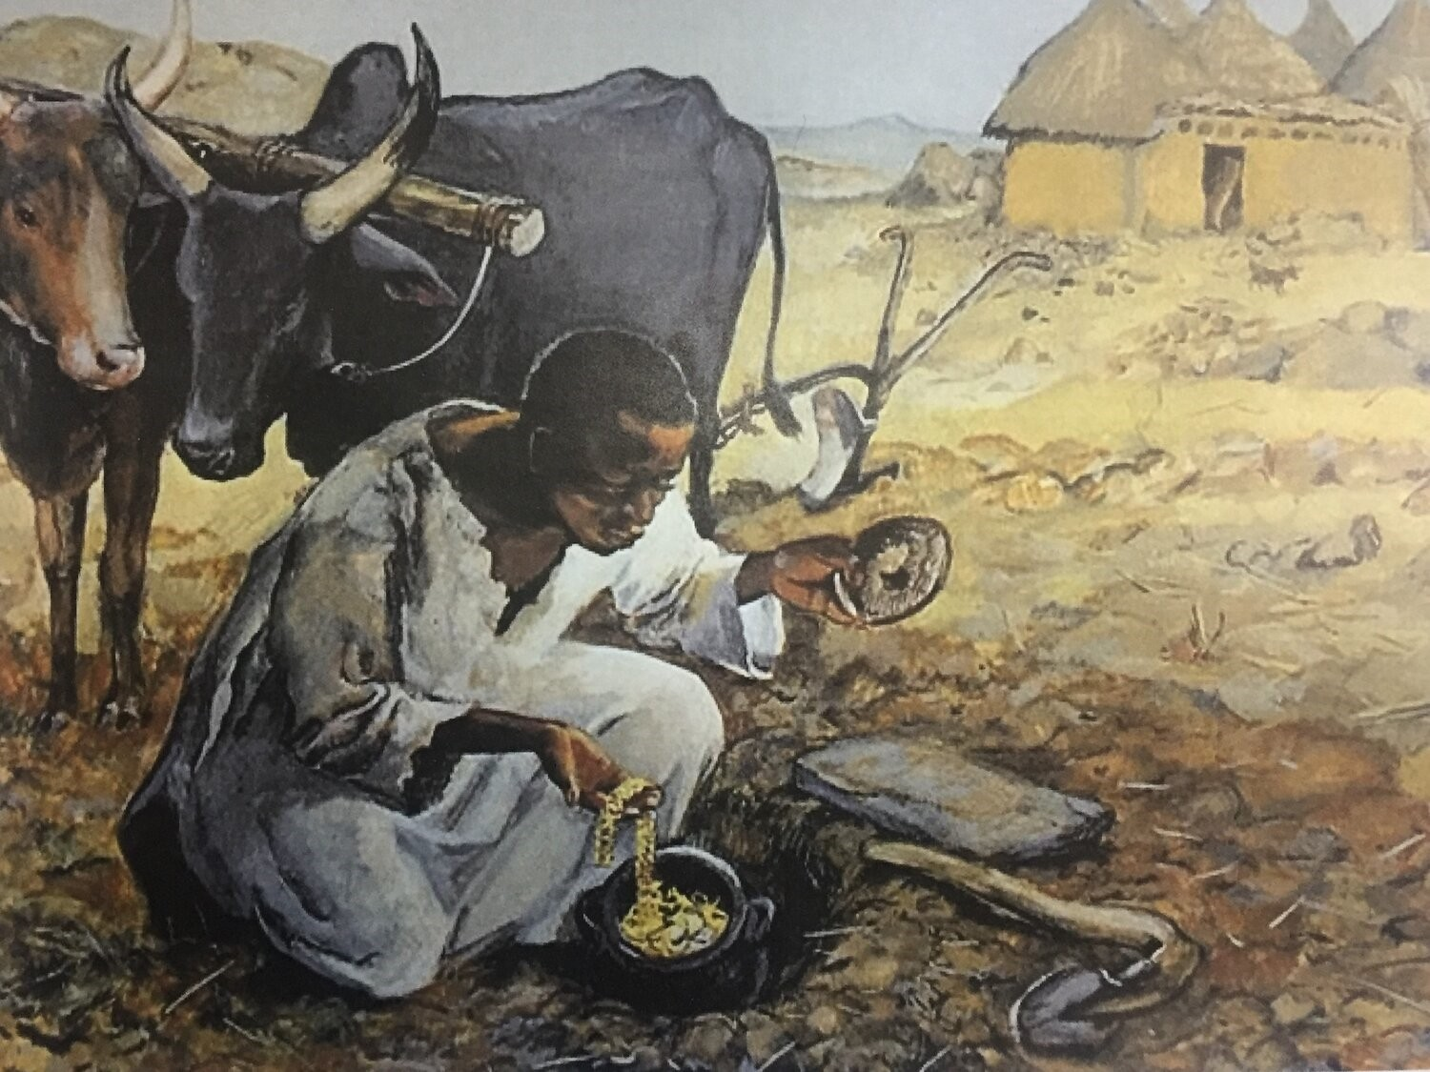
Matthew 13:44

Slide 12
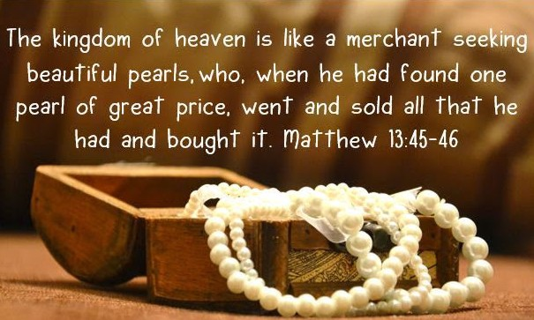
Matthew 13:45-46

Slide 13
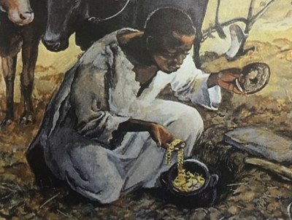
Matthew 13:44
Value
Findable
Joy
Motivates change

Slide 14
Matthew 13:45-46
Value
Findable
Motivates change

Slide 15
Matthew 13:44-46
Value?
Have you found it?
Does it bring Joy?
Any changes?

Slide 16
severe one tie to attach to another - Paul loved Timothy.

