Slide 1
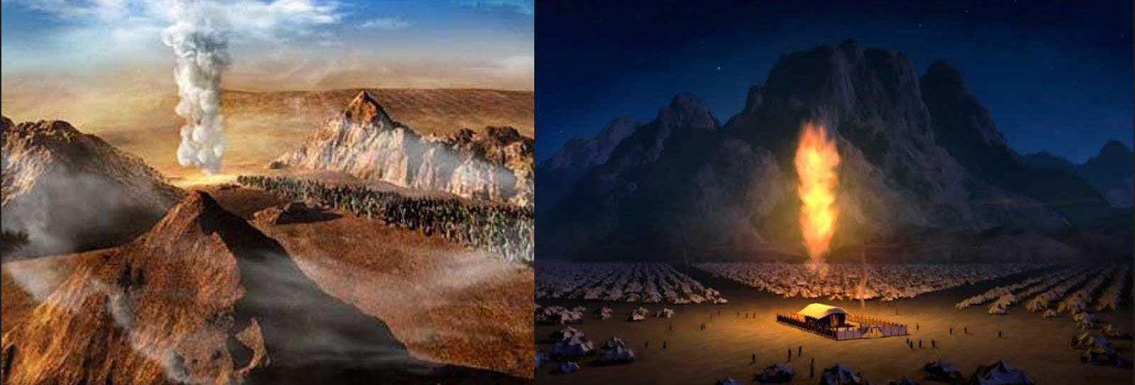
Masks
No Masks

Slide 2
severe one tie to attach to another - Paul loved Timothy.

Slide 3
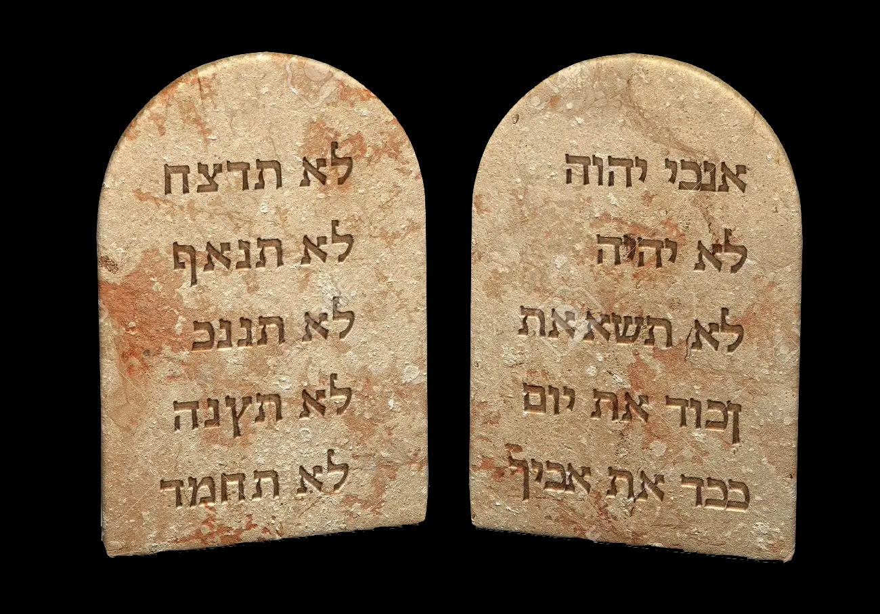
To whom was God speaking?
Deuteronomy 5:4-5, 22-27

Slide 4
severe one tie to attach to another - Paul loved Timothy.
Why?
Romans 3:19-20
Romans 7:7-13

Slide 5
severe one tie to attach to another - Paul loved Timothy.
2 “I am the Lord your God, who brought you out of the land of Egypt, out of the house of slavery.

Slide 6
severe one tie to attach to another - Paul loved Timothy.
3 “You shall have no other gods before Me.

Slide 7
severe one tie to attach to another - Paul loved Timothy.
4 “You shall not make for yourself an idol, or any likeness of what is in heaven above or on the earth beneath or in the water under the earth. 5 You shall not worship them or serve them; for I, the Lord your God, am a jealous God, visiting the iniquity of the fathers on the children, on the third and the fourth generations of those who hate Me, 6 but showing lovingkindness to thousands, to those who love Me and keep My commandments.

Slide 8
severe one tie to attach to another - Paul loved Timothy.
7 “You shall not take the name of the Lord your God in vain, for the Lord will not hold him guiltless who takes his name in vain.

Slide 9
severe one tie to attach to another - Paul loved Timothy.
8 “Remember the sabbath day, to keep it holy. 9 Six days you shall labor and do all your work, 10 but the seventh day is a sabbath of the Lord your God; in it you shall not do any work, you or your son or your daughter, your male or your female servant or your cattle or your sojourner who stays with you. 11 For in six days the Lord made the heavens and the earth, the sea and all that is in them, and rested on the seventh day; therefore the Lord blessed the sabbath day and made it holy.
Mark 2:27

Slide 11
Romans 7:7-13

Slide 13
severe one tie to attach to another - Paul loved Timothy.

Slide 14
severe one tie to attach to another - Paul loved Timothy.

