Slide 2
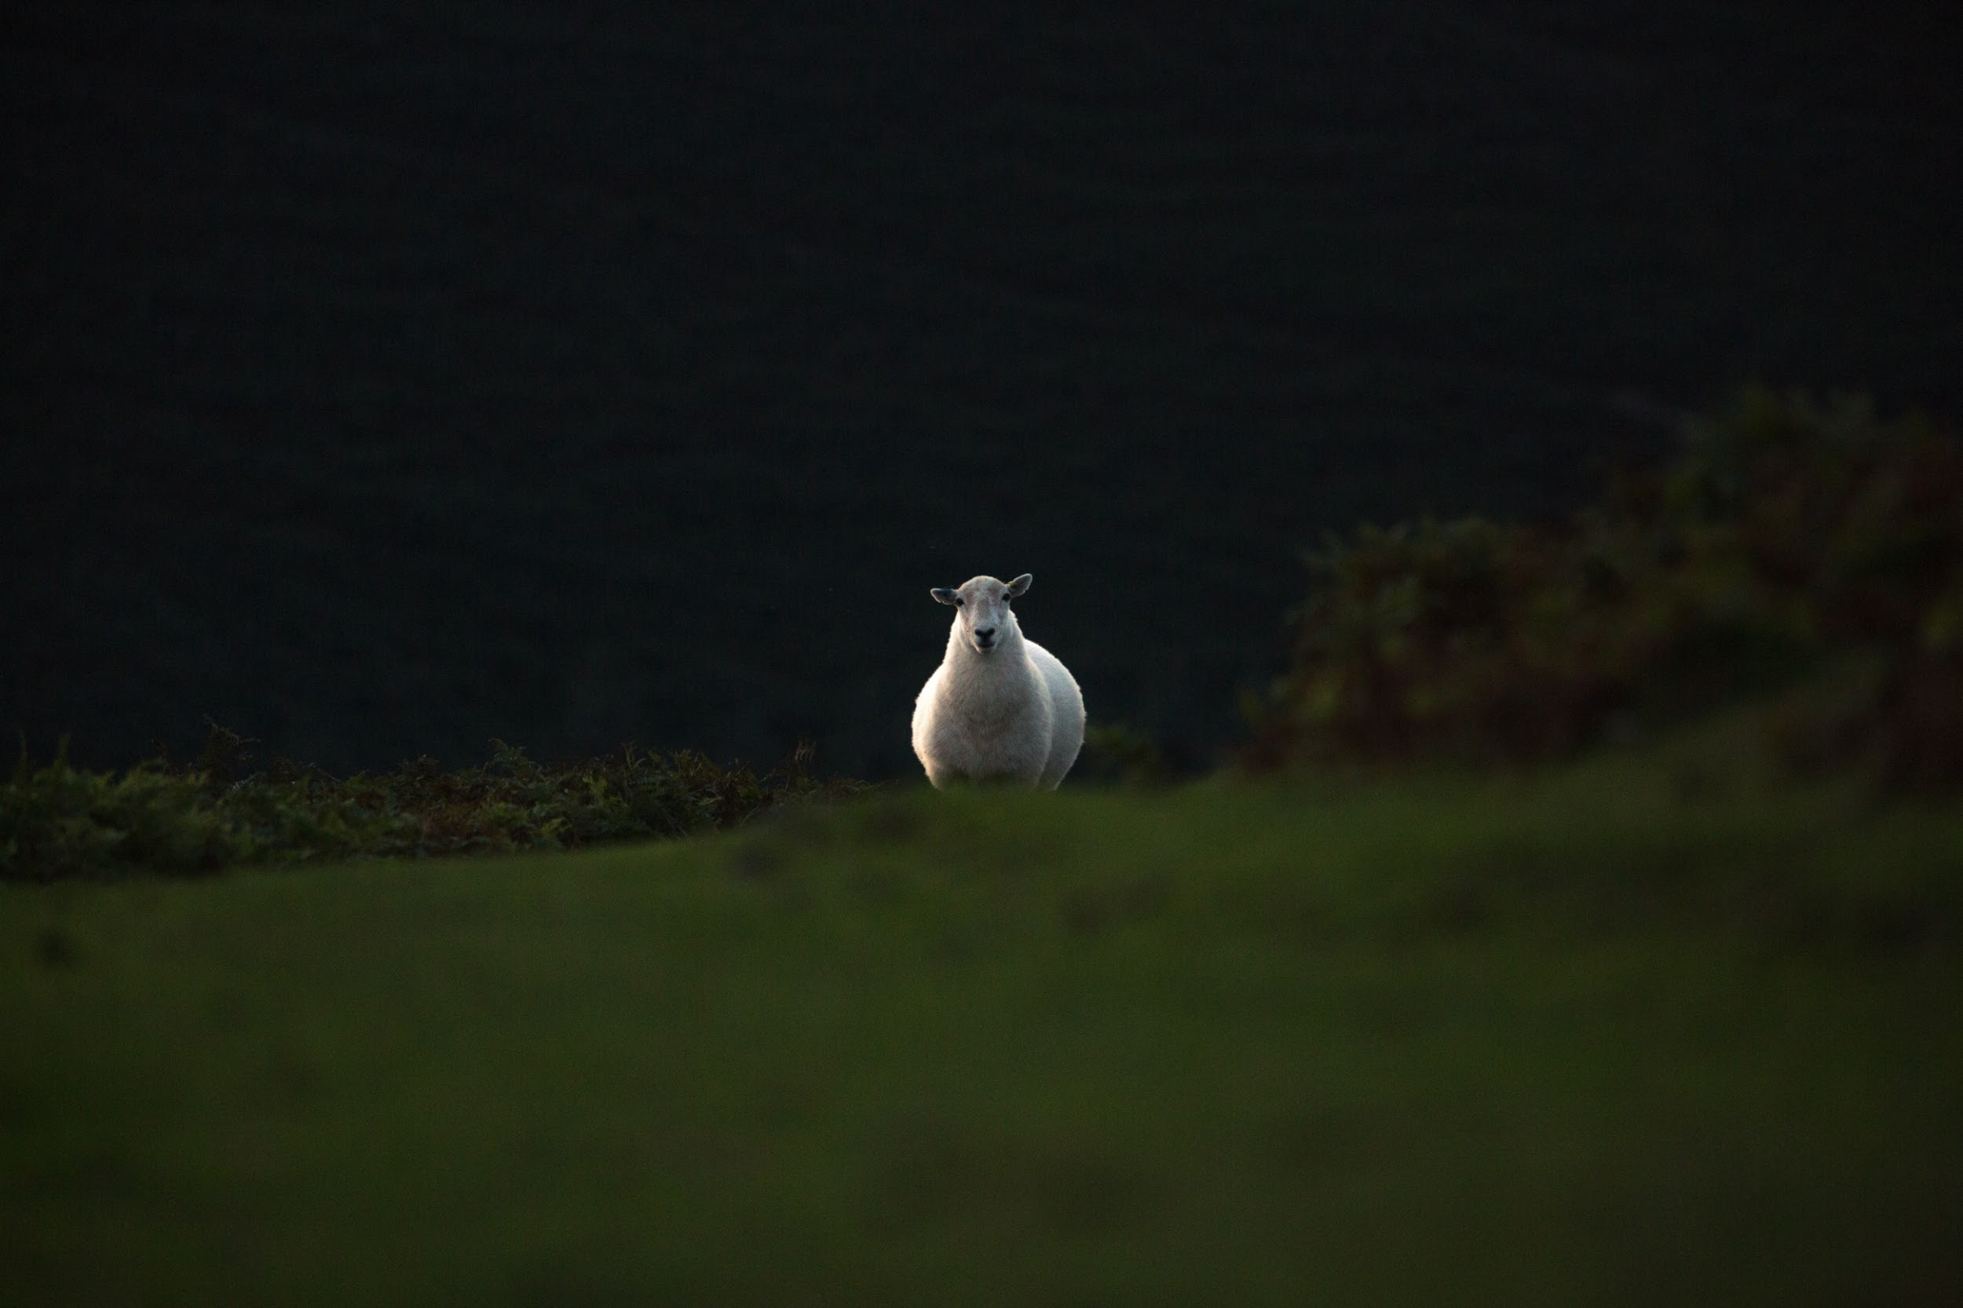
Luke 15:1-10

Slide 3
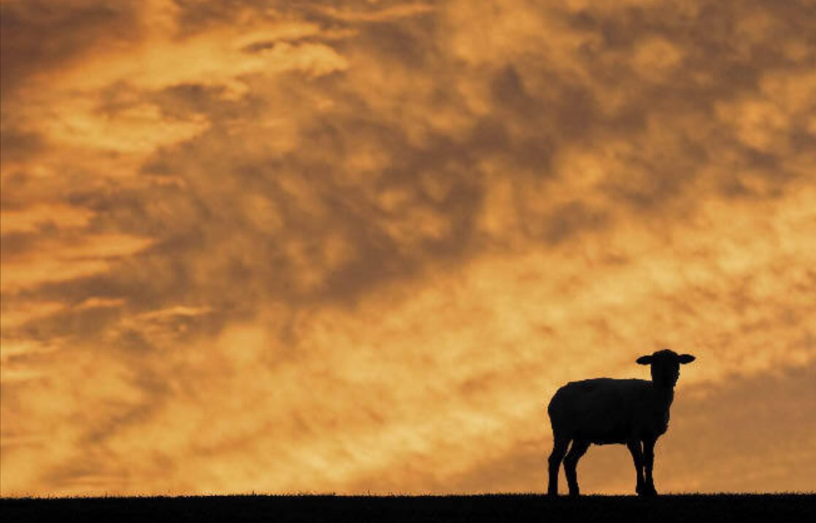
The Shepherd:
Made a plan
Made some risk
Rejoiced at the rescue

Slide 4
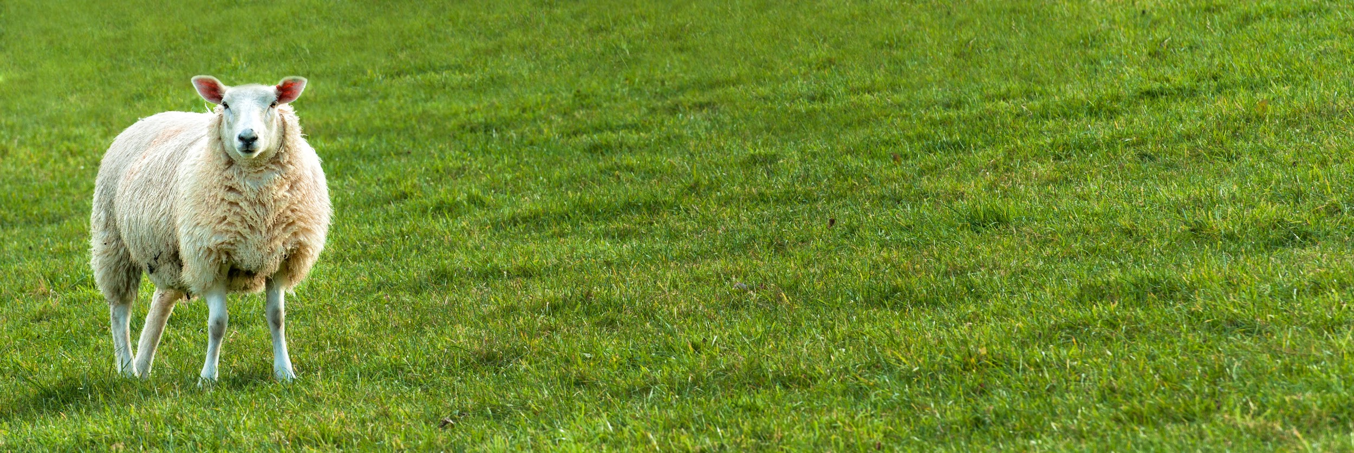
Isaiah 53:10
But the Lord was pleased To crush Him, putting Him to grief; If He would render Himself as a guilt offering, He will see His offspring, He will prolong His days, And the good pleasure of the Lord will prosper in His hand.

Slide 5
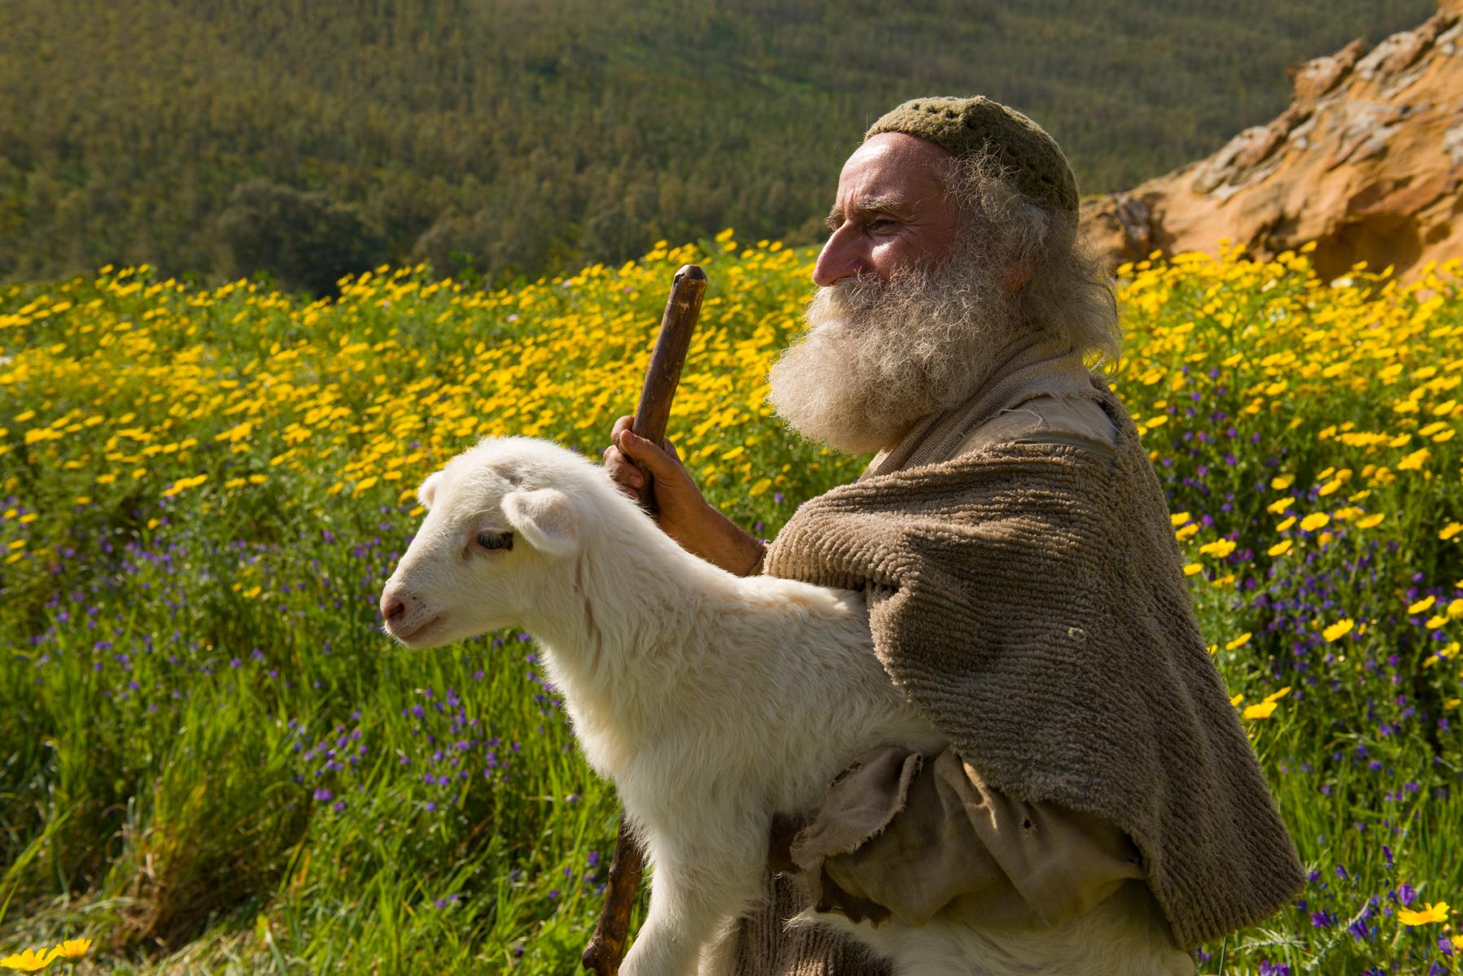
Rejoice with me,
for I have found my sheep which was lost!.

Slide 6
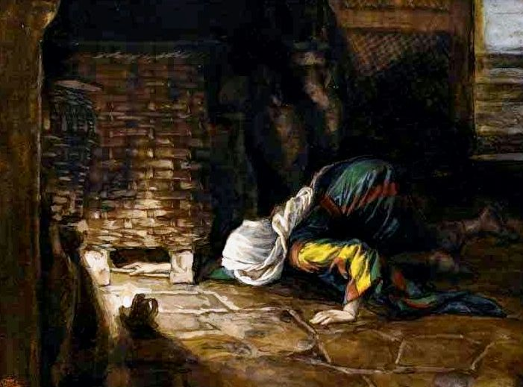
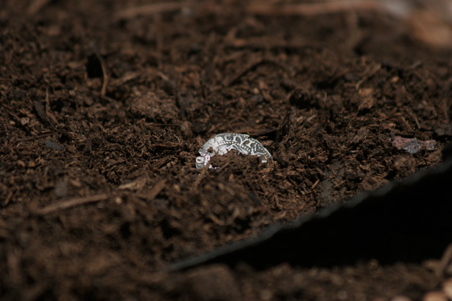
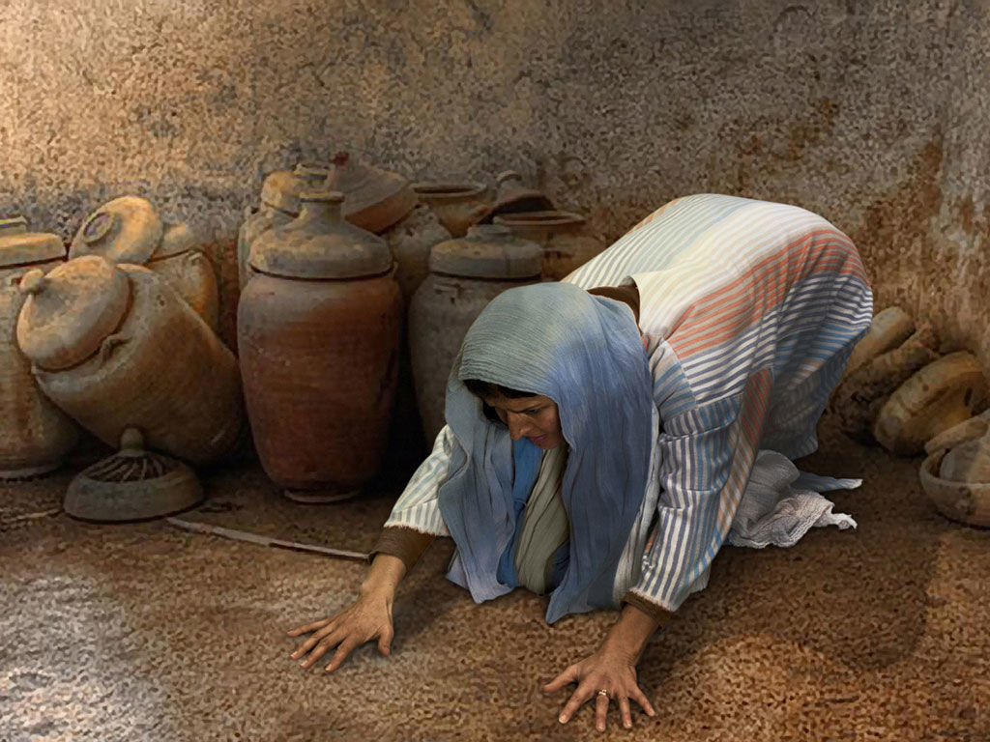
Significant loss
Significant effort

Slide 7
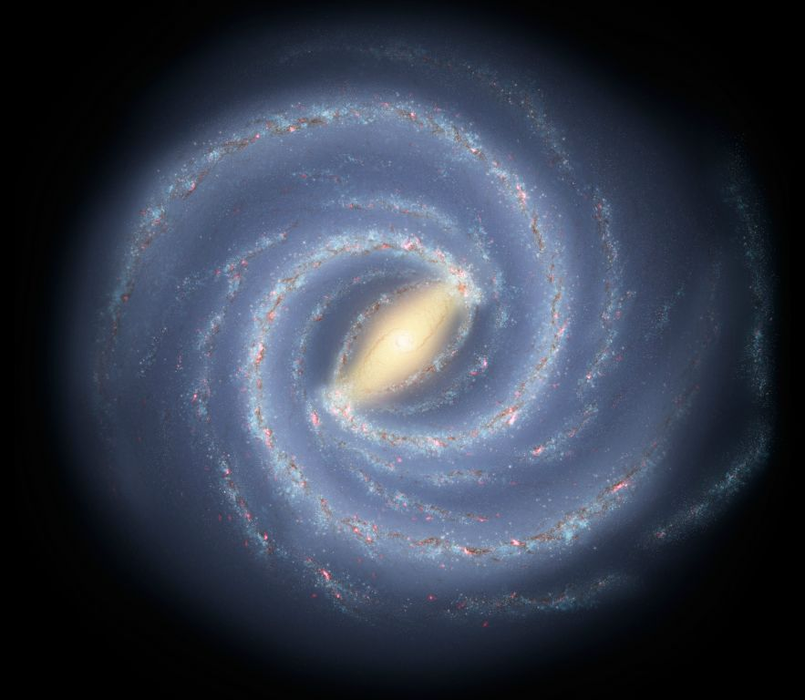
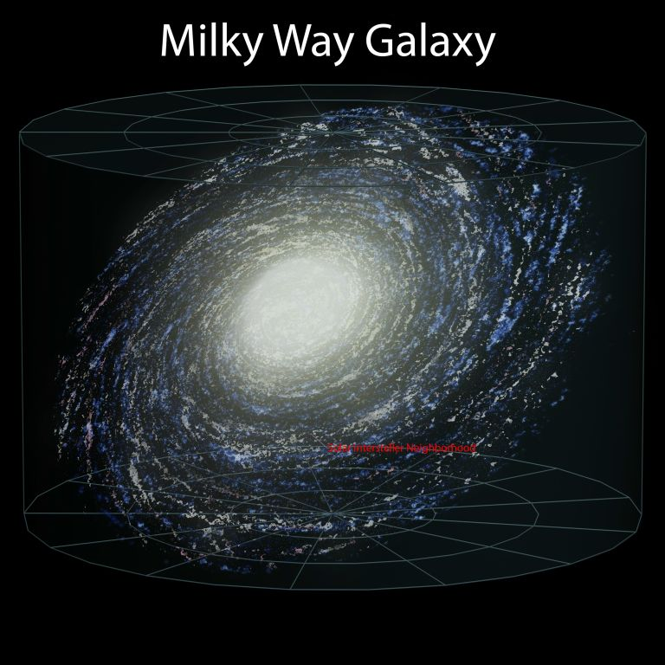
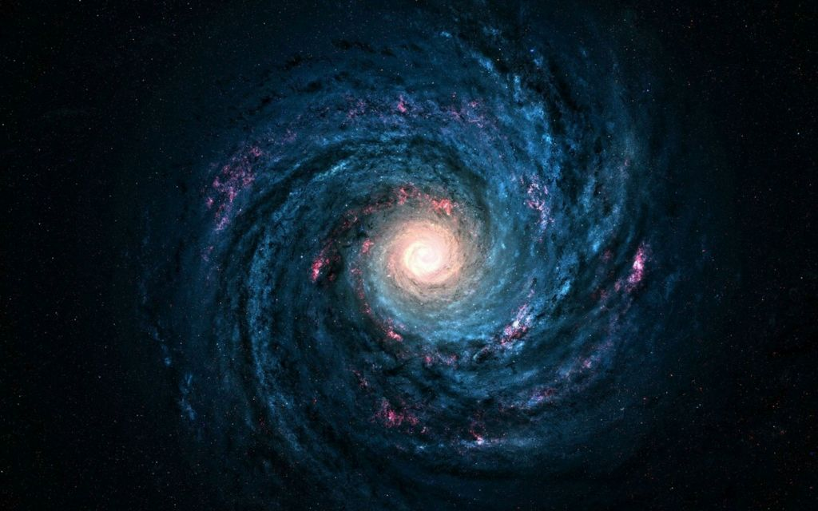
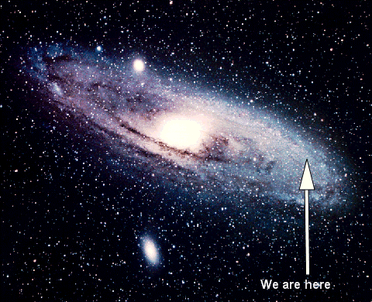
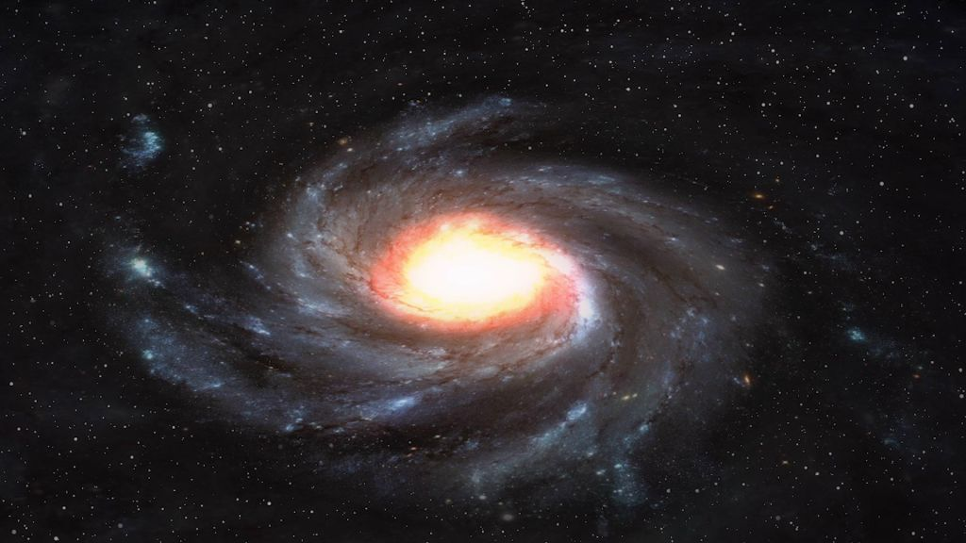
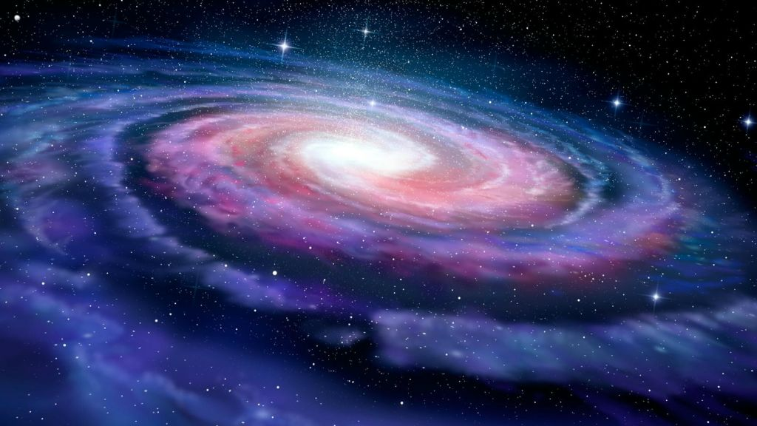

Slide 8
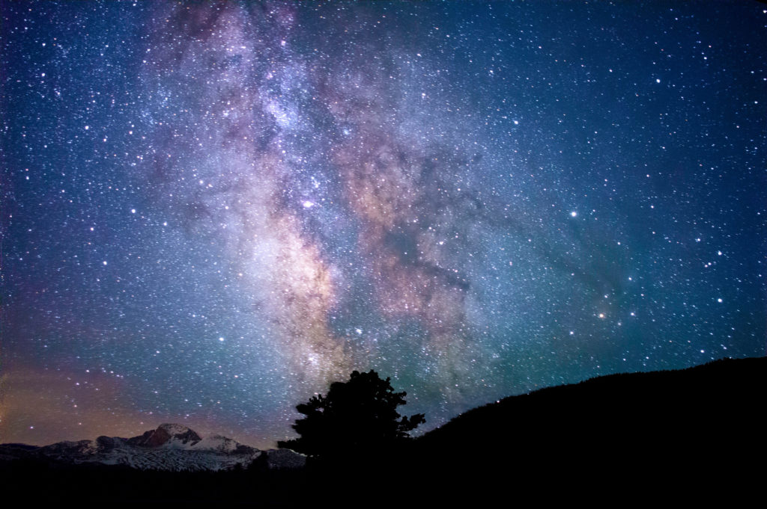
1,000,000,000,000,000,000,000,000

Slide 9
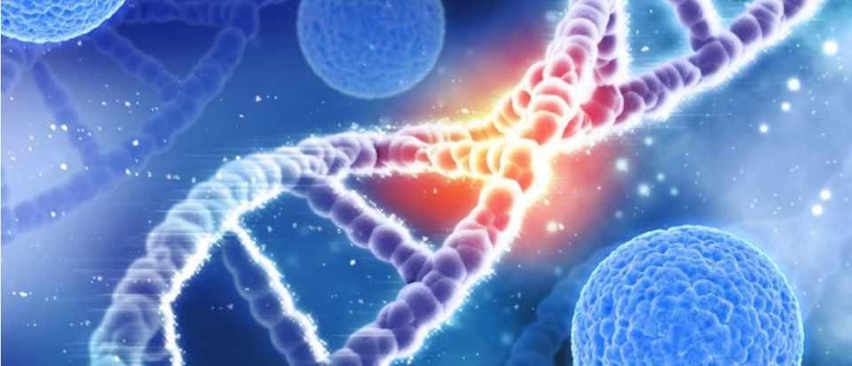
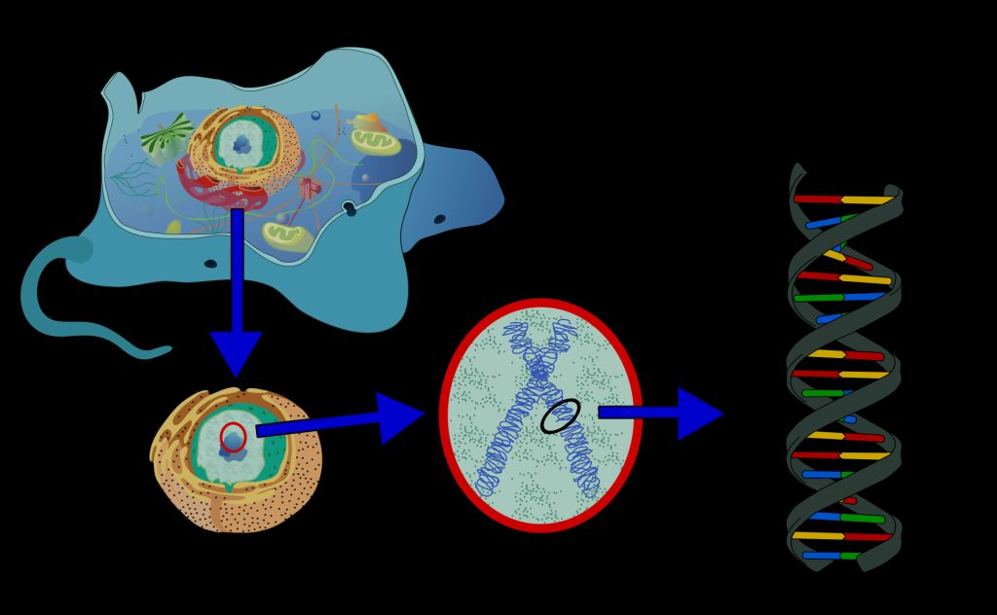

Slide 10
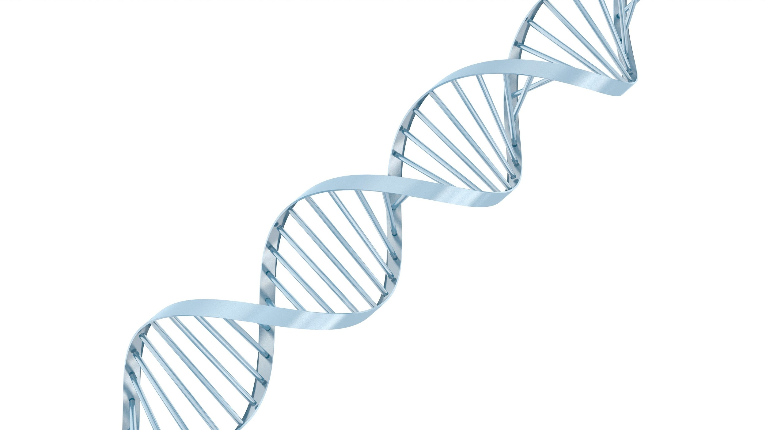

Slide 11
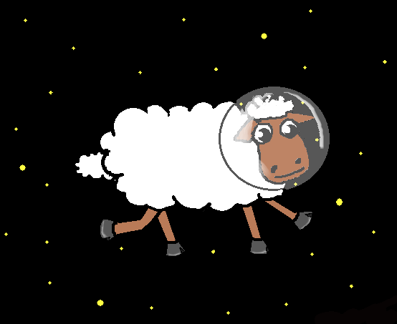

Slide 12
Matthew 10:29
Are not two sparrows sold for a cent? And yet not one of them will fall to the ground apart from your Father. 30 But the very hairs of your head are all numbered. 31 So do not fear; you are more valuable than many sparrows.
Jeremiah 32:17
Ah Lord GOD! Behold, You have made the heavens and the earth by Your great power and by Your outstretched arm! Nothing is too difficult for You
Genesis 18:14 Is anything too difficult for the Lord?

Slide 13
Psalm 8:3–4
When I look at your heavens, the work of your fingers, the moon and the stars, which you have set in place, what is man that you are mindful of him, and the son of man that you care for him?
Psalm 147:5
Great is our Lord, and abundant in power; his understanding is beyond measure.
Jeremiah 32:27 Behold, I am the LORD, the God of all flesh. Is anything too difficult for Me?

Slide 14
Revelation Chapter 2 and 3
“I know your deeds”

Slide 15
1 Thessalonians 5:9-11
For God has not destined us for wrath, but for obtaining salvation through our Lord Jesus Christ, who died for us, so that whether we are awake or asleep, we will live together with Him. Therefore encourage one another and build up one another, just as you also are doing.

