Slide 3
Lessons from The Garden
Genesis 1:26 - 2:25

Slide 4
Conclusion
In the garden, immortal God walked and talked with immortal man. I want to return to that state of being.

Slide 5
Is the Genesis garden real?
Matt 19:4-6; 1 Cor 15, 1 Tim 2

Slide 6
Order
Intellectual - Genesis 1:28 - fill, rule, and subdue
Biological - v27 - male and female
Familial - vs 2:22-25 - marriage
Spiritual - Soul from God is good 2:7. That which is from God is good 1:31, His word is just, true, loving, and good 2:16-17

Slide 7
Observations
Prayer - 2:18-21
Providence - 2:15-17
Placement - 2:8
Career - 2:15

Slide 8
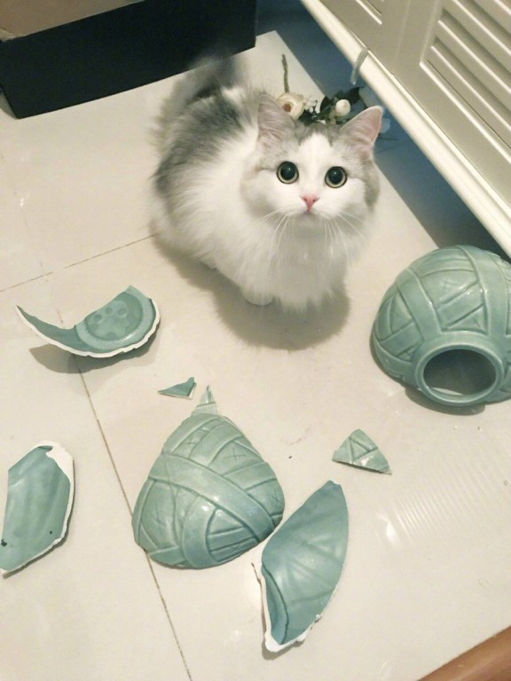
SO,
WHAT HAPPENED
?
Genesis 3

Slide 9
Romans 8:22

Slide 10
Discontent

Slide 11
Discontent
In the garden, as long as we were content, we had a relationship with God and had nothing to fear.
Unhappiness did not exist until discontent was invented.

Slide 12
Am I Content:
Where God has placed me?
With his providence?
With his loving instructions?

Slide 13
Contentment
≠
Complacency

Slide 14
Do I Blaspheme and Besmirch God?

Slide 15
Matthew 10:29
Are not two sparrows sold for a cent? And yet not one of them will fall to the ground apart from your Father. 30 But the very hairs of your head are all numbered. 31 So do not fear; you are more valuable than many sparrows.
Colossians 3:22
...obey those who are your masters on earth, not with external service, as those who merely please men, but with sincerity of heart, fearing the Lord.
Genesis 3:12 ...“The woman whom You gave to be with me, she gave me from the tree, and I ate.”

Slide 16
Romans 13:1–2
Every person is to be in subjection to the governing authorities. For there is no authority except from God, and those which exist are established by God. Therefore whoever resists authority has opposed the ordinance of God; and they who have opposed will receive condemnation upon themselves.
John 6:40
For this is the will of My Father, that everyone who beholds the Son and believes in Him will have eternal life, and I Myself will raise him up on the last day.”

Slide 17
2 Samuel 12:14 ...by this deed you have given occasion to the enemies of the Lord to blaspheme

Slide 18
Philippians 4:11 Not that I speak from want, for I have learned to be content in whatever circumstances I am.
1 Timothy 6:6 But godliness actually is a means of great gain when accompanied by contentment.
1 Timothy 6:8 If we have food and covering, with these we shall be content.
Hebrews 13:5 Make sure that your character is free from the love of money, being content with what you have; for He Himself has said, “I will never desert you, nor will I ever forsake you,”

